Slide 1
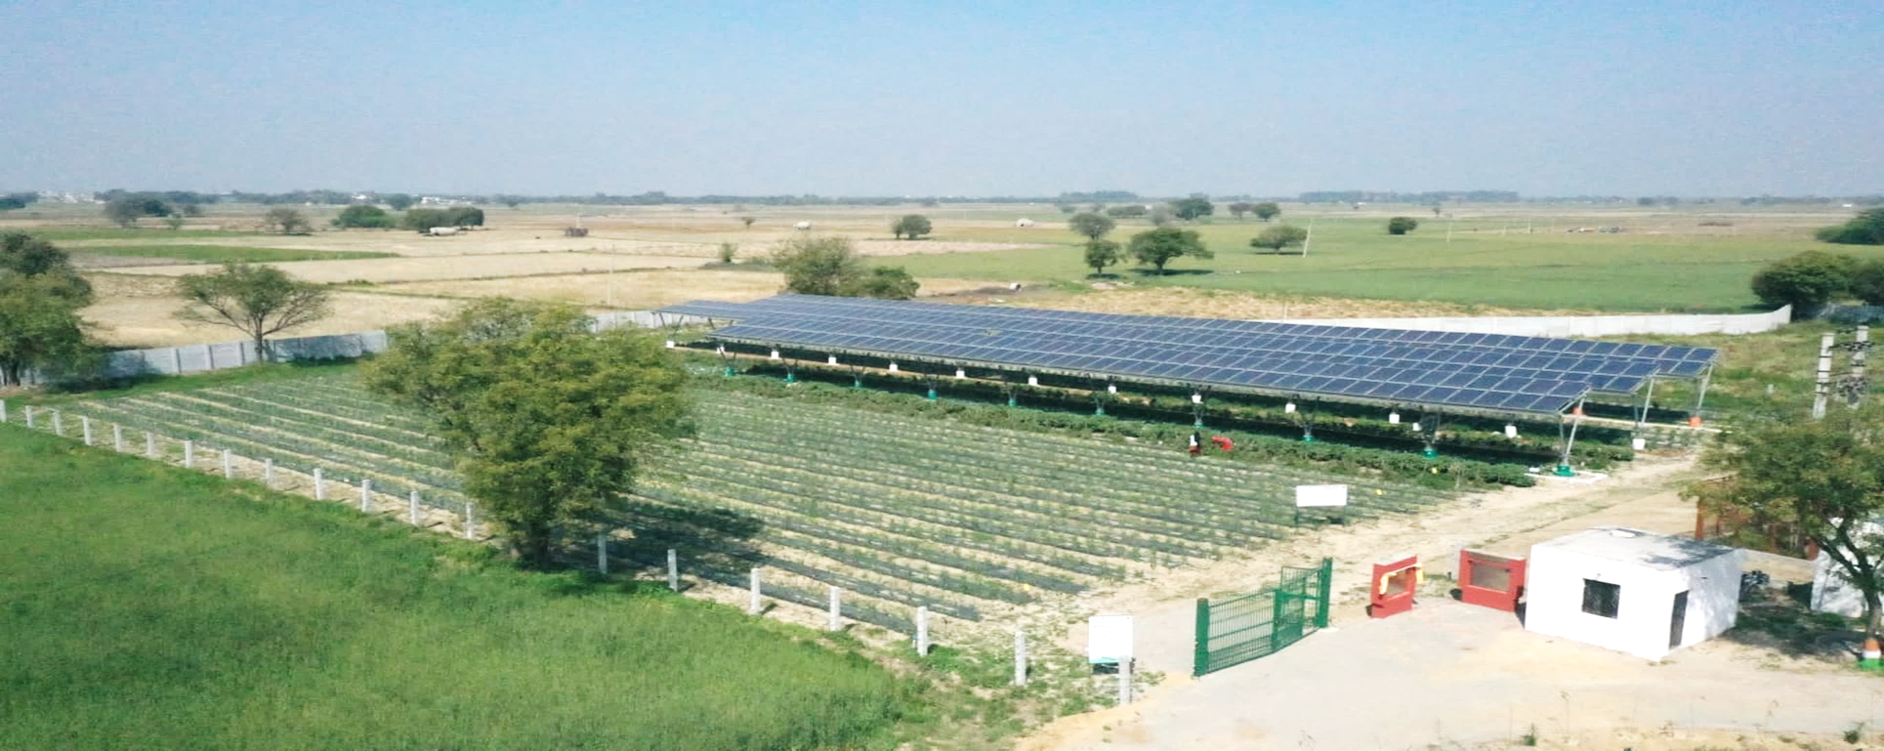


KVK (NHRDF), DELHI
Innovative Approach : Solar Farm Demonstration Unit
Dr. P. K. Gupta, NHRDF

Slide 2
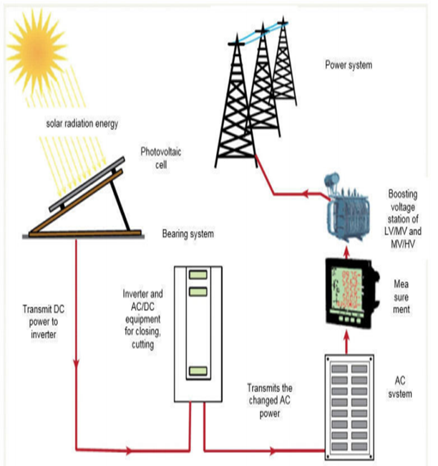
KVK (NHRDF), DELHI

Slide 3

KVK (NHRDF), Delhi
Objectives:
Aims to hit two birds with one stone at the same time.
The increase income of farmers by setting up solar plants in their agriculture land,
Protect green belt of NCT, Delhi
Save the environment by reducing Pollution

Slide 4
KVK (NHRDF), DELHI
Brief About SFDU
Sl. No. | Description | Details
1 | Project capacity | 110 KW
2 | Commissioning | 11 February 2021
3 | Area under SFDU | 2000 Meter Square
4 | Project developer | Oakridge Energy
5 | Financial Support | Delhi Transco Limited ,GNCT Delhi (Rs 78.45 Lakhs )
 |  | NABARD : Rs 24.80 Lakhs
6 | Mounting structure | 80-100 micron hot dipped galvanized structure with 3.5 meters elevation
7 | Distribution of power | Through virtual net metering – NAFED :NHRDF:KVK ; 70:20:10
9 | Per Month Energy Production | RASCO Model Average : 15000 Unit ,Purchase Price : Rs 3.13/Unit Sale price per unit : Rs 4/- benefit : Rs.0.87/-X 15000=Rs 13050/Months Per annum: Rs 156600/-
10 | Suitable crops | Leafy Vegetables, Cucurbitaceous and Solaneceous Crops

Slide 5
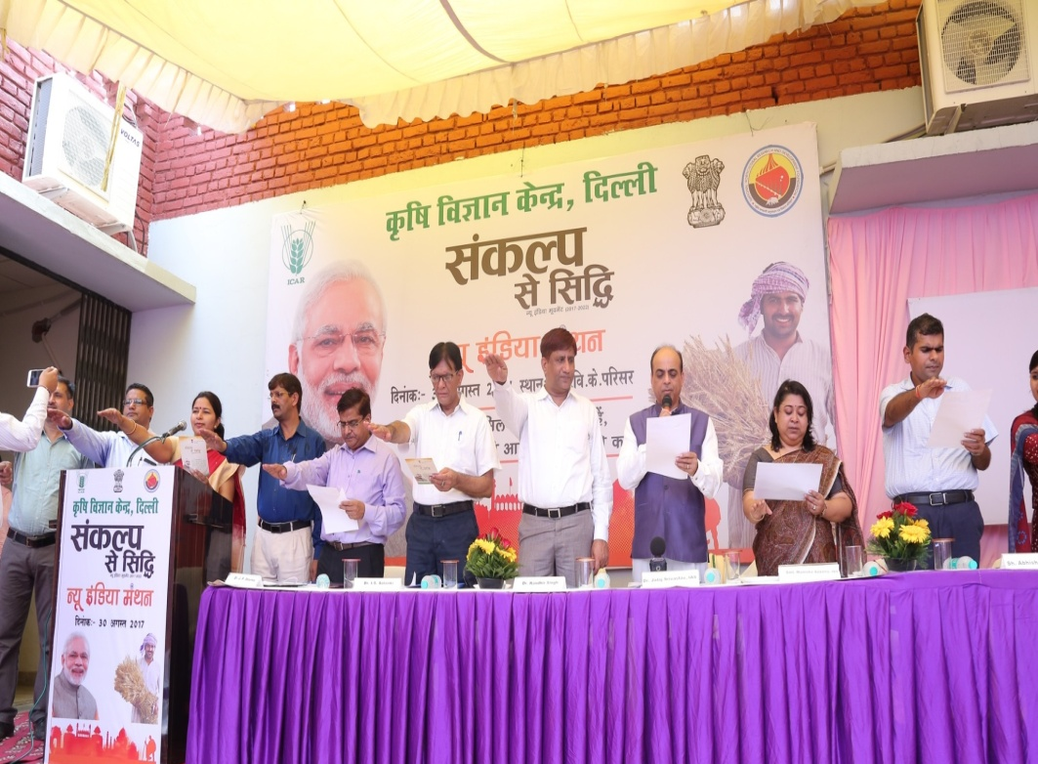
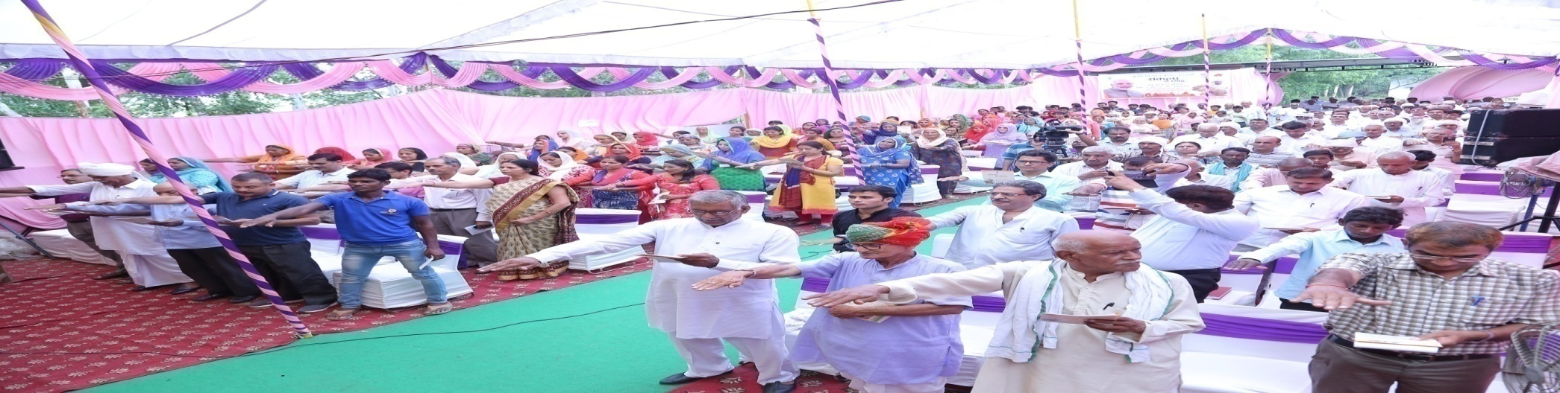
KVK (NHRDF), Delhi
Sankalp Se Siddhi Programme
Date – 30/08/2017
Chief Guest– Sh. Jalaj Srivastava, Additional Secretary, Ministry of Agriculture & Farmer's Welfare, Govt. of India

Slide 6
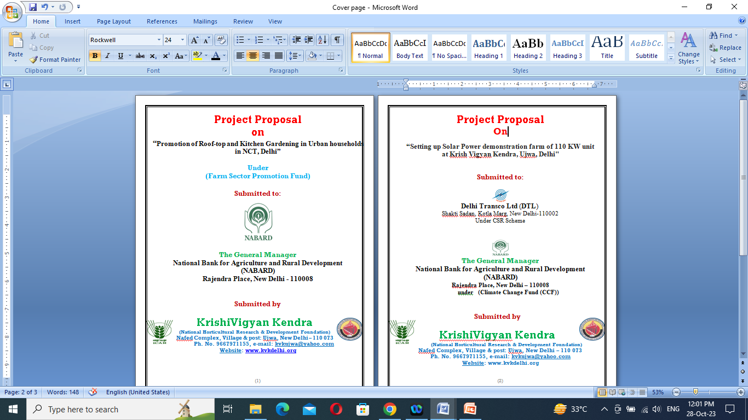
KVK (NHRDF), Delhi
.

Slide 7
KVK (NHRDF), Delhi
Financial approval
NABARD, Delhi - Rs. 24.80 Lakhs (NB.Ro.Delhi/853/CCf-KVK-POD 74 (1)/2019-20) / 21st October, 2019
Delhi Transco Limited, (under CSR Initiative), GNCT, Delhi - Rs. 78.45 Lakhs (Purchase order: 5900000035 / 25th November, 2019

Slide 8
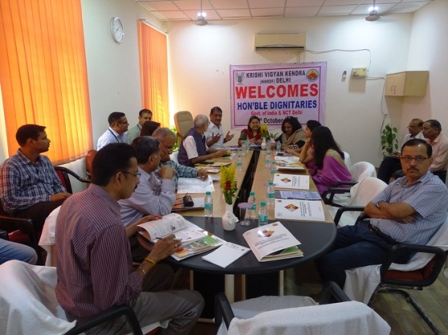
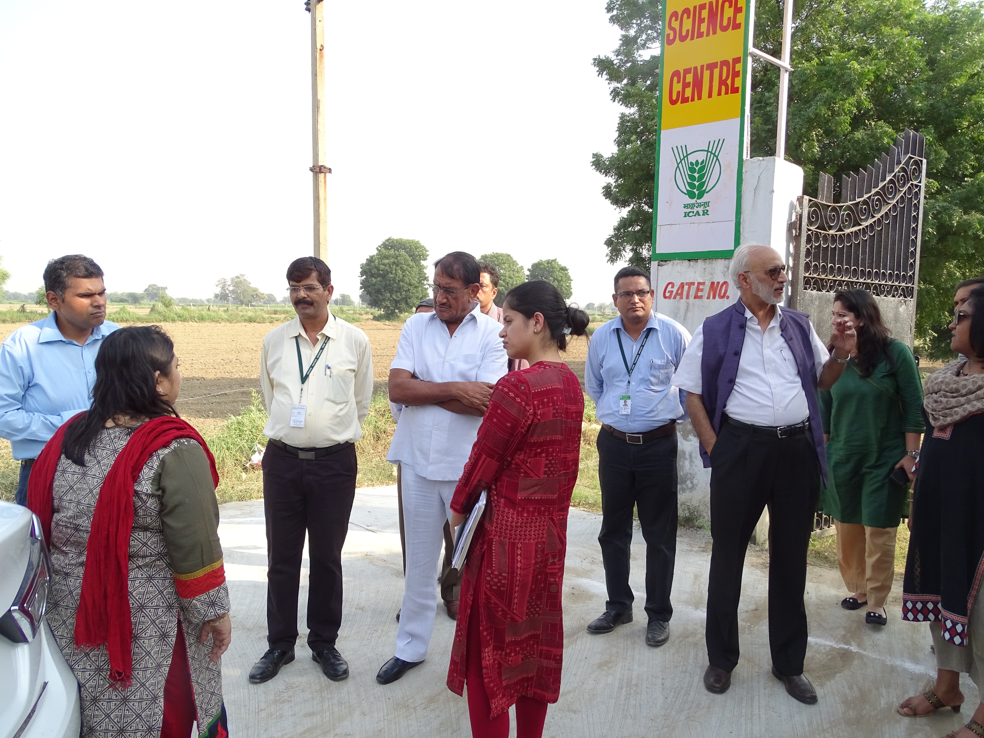
KVK (NHRDF), Delhi
Meeting under chairmanship of Mrs. Manisha Saxena, IAS, Divisional Commissioner, GNCT, Delhi (05th October, 2018)

Slide 9
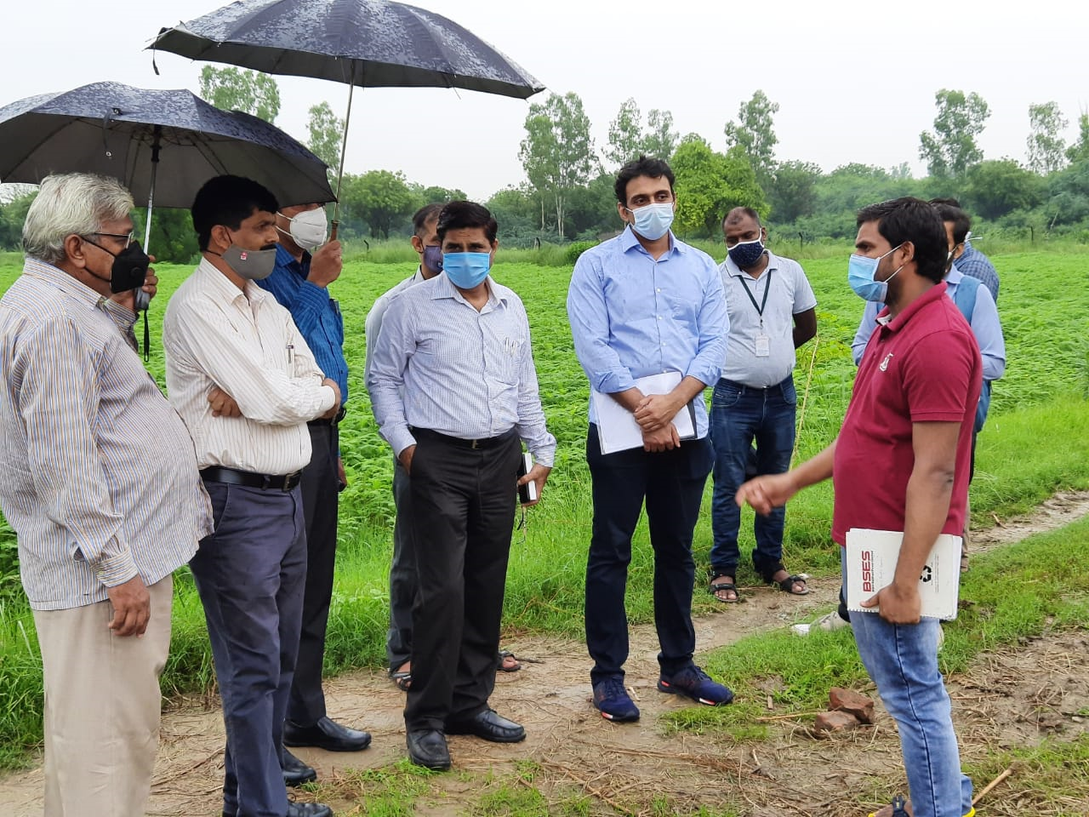
KVK (NHRDF), Delhi
Selection of site by official from Solar Department
GNCT Delhi, NAFED, BSES and vendor on 19 August, 2020

Slide 10
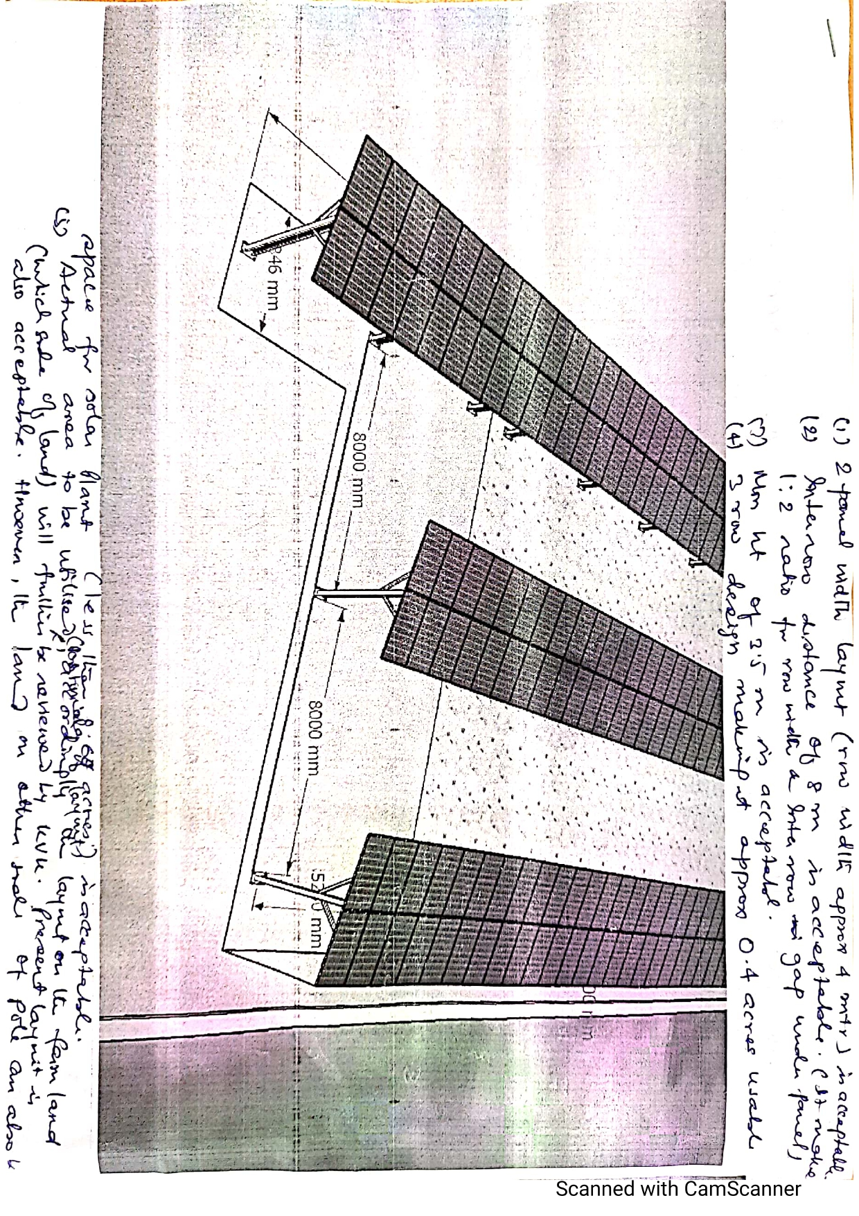
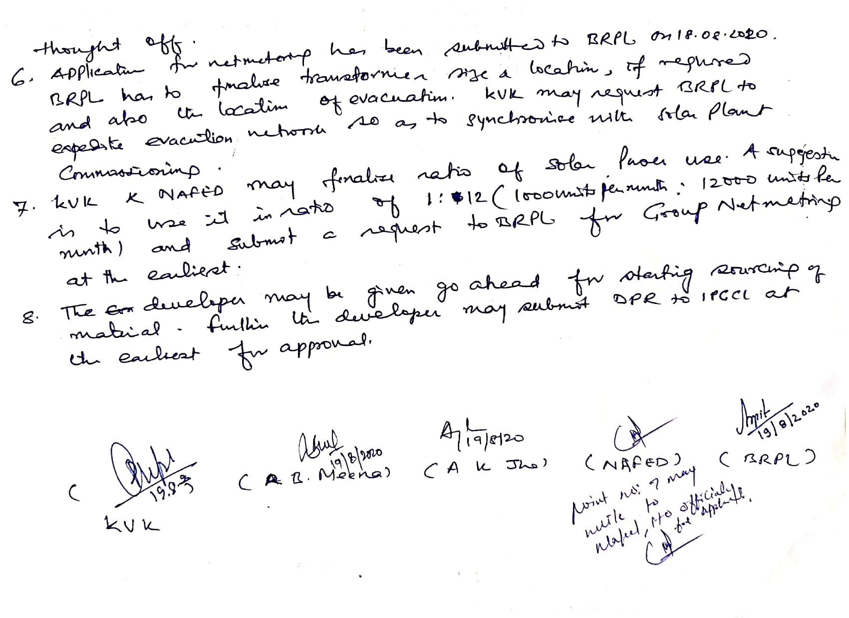
KVK (NHRDF), Delhi
Layout Solar Farm Demonstration unit at KVK
.

Slide 11
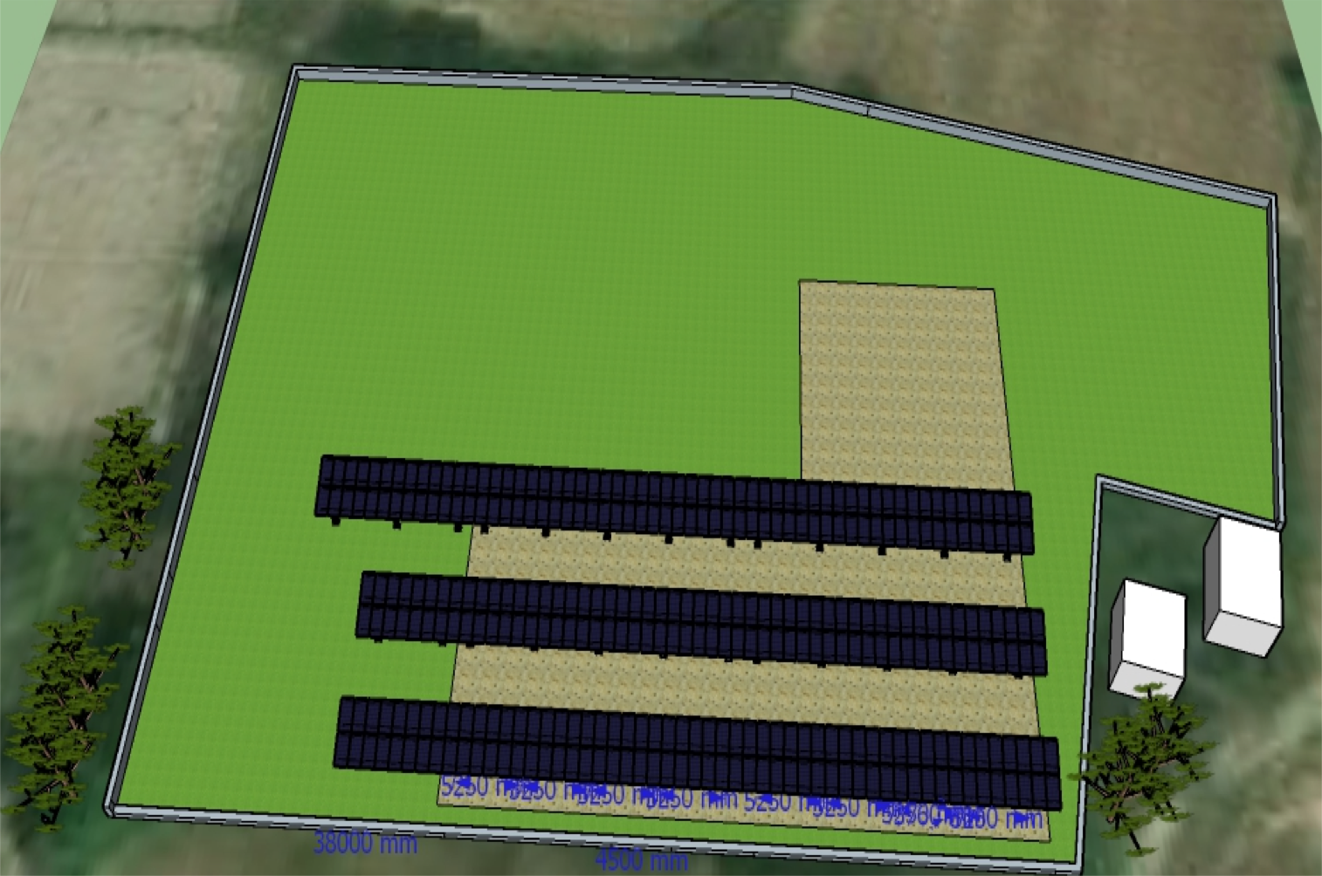
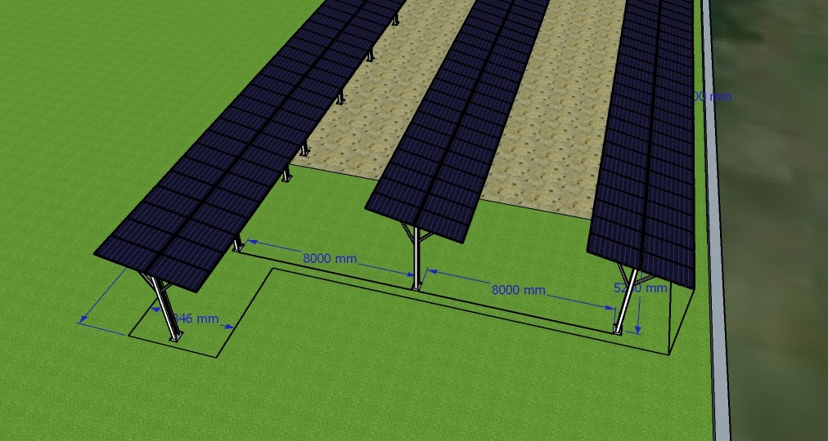
Unique Layout design …
KVK (NHRDF), DELHI
Organized into three rows of solar panels
Each row has 2 panel elevated structure
8 meters distance between each
row of panels
Distance between columns – 5.25 meters
Crops - Okra, tomato, brinjal, capsicum, leafy vegetables, root vegetables and cole crops
Design is spread out to ensure minimum obstruction to farming
Only 2 panel frame – to minimize
shadow on crops
Distance between columns ensures mechanized equipment can travels

Slide 12
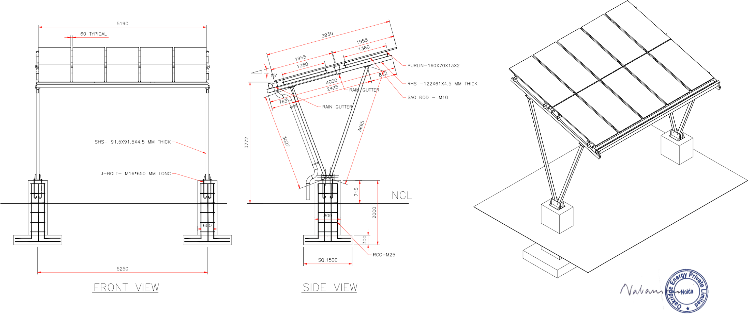
Structural design
KVK (NHRDF), DELHI
Deep columns to ensure safety and stability of structure
Rain gutter to ensure draining rain / cleaning water
Height – 3.7 meters – ensures mechanized equipment can pass through

Slide 13
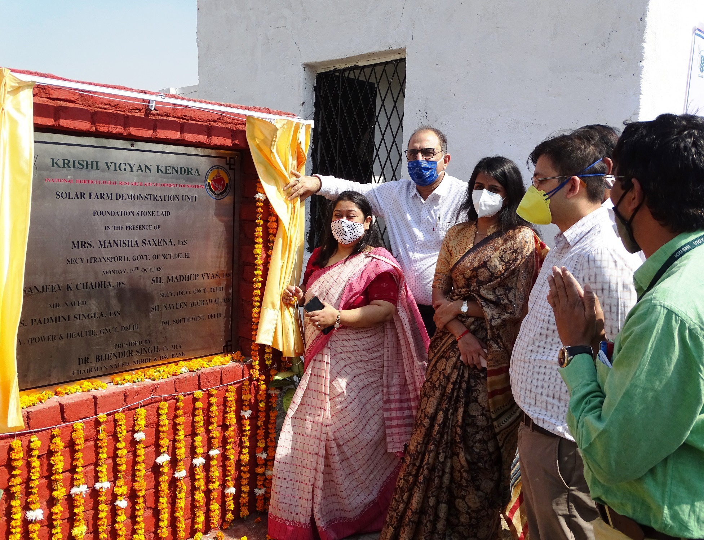
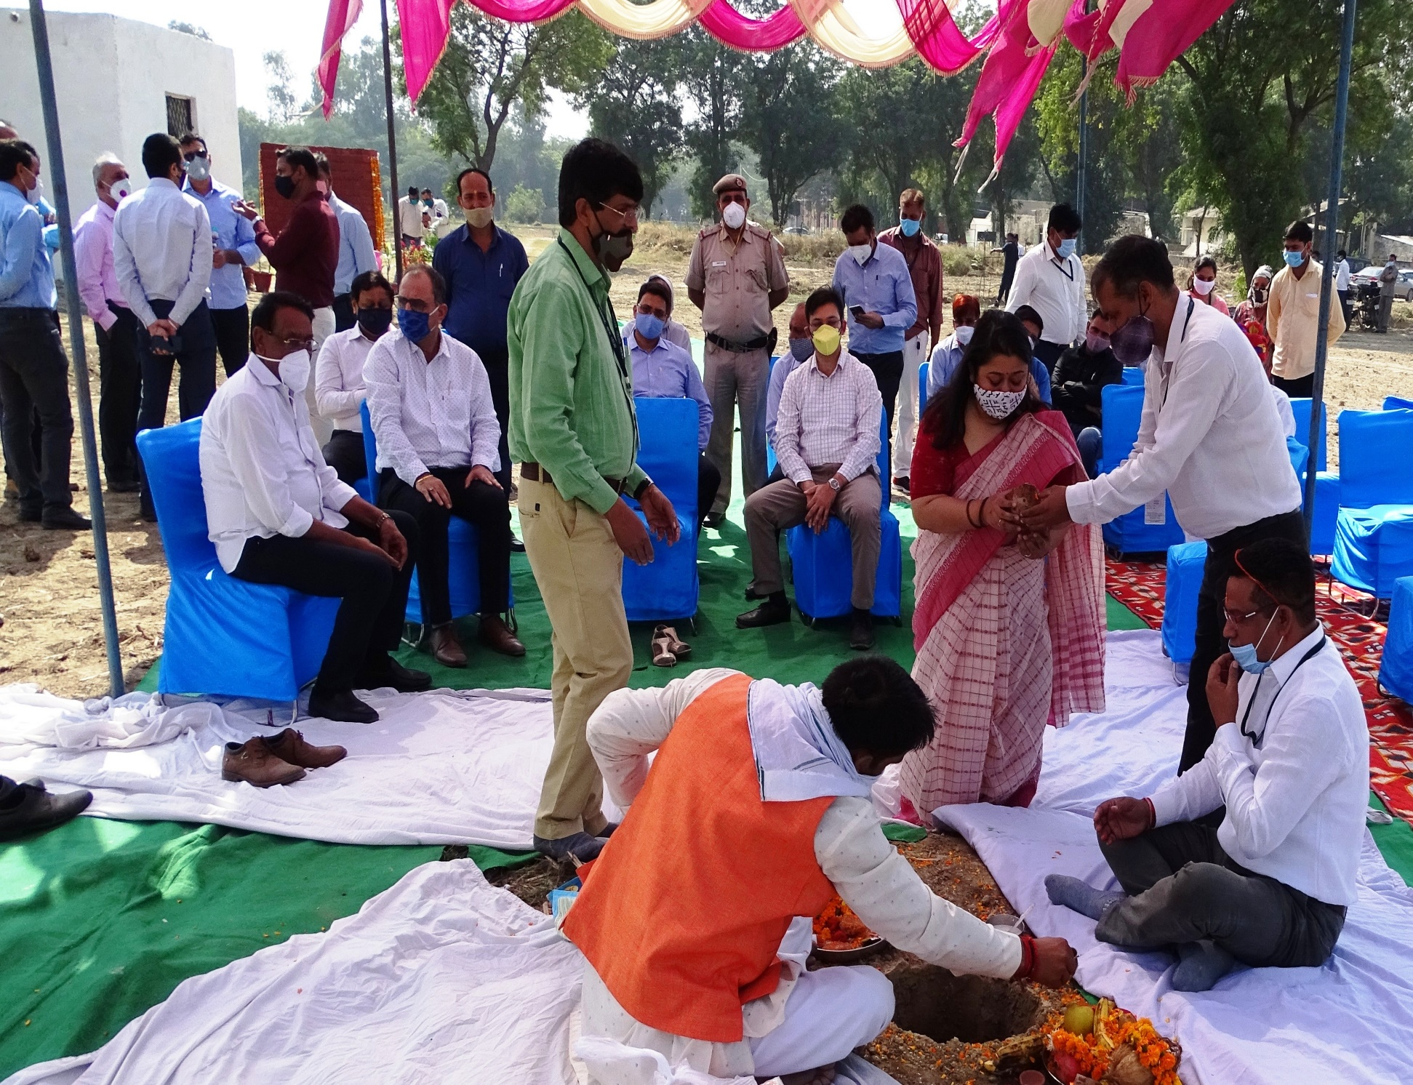
KVK (NHRDF), Delhi
Foundation Stone Ceremony on 19 Oct 2020

Slide 14
KVK (NHRDF), Delhi
Foundation Stone Ceremony on 19 Oct 2020
Chief Guest : Smt. Manisha Sexena, IAS, Secretary, GNCT, Delhi,
Presided by : Dr Bijender Singh,President,NHRDF &NAFED
Guest of Honour : Sh S K Chadha, IFS, Managing Director, NAFED
Dr. Naveen Aggarwal, IAS. District Magistrate, South . West Delhi
Ms. Soumaya Sharma, IAS, SDM,
Mr. Vikash Bhatt, AGM, NABARD

Slide 15
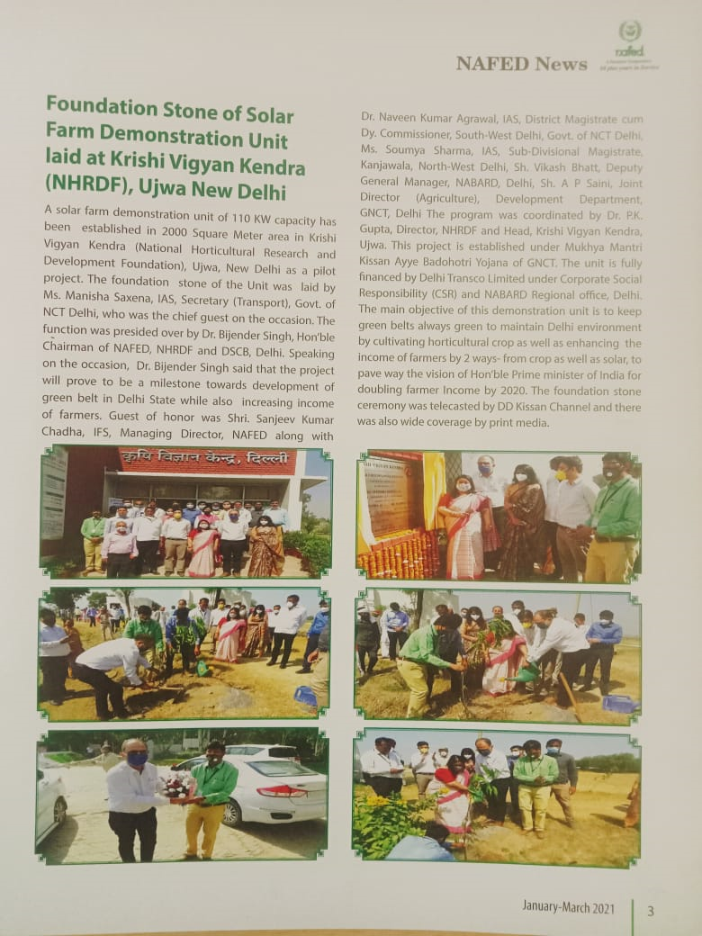
KVK (NHRDF), Delhi
Media Coverage

Slide 16
KVK (NHRDF), Delhi
MoU with KVK, NHRDF and NAFED (10:20:70) for utilization of power through Virtual Net Metering BSES Grid
on 04th February, 2021

Slide 17
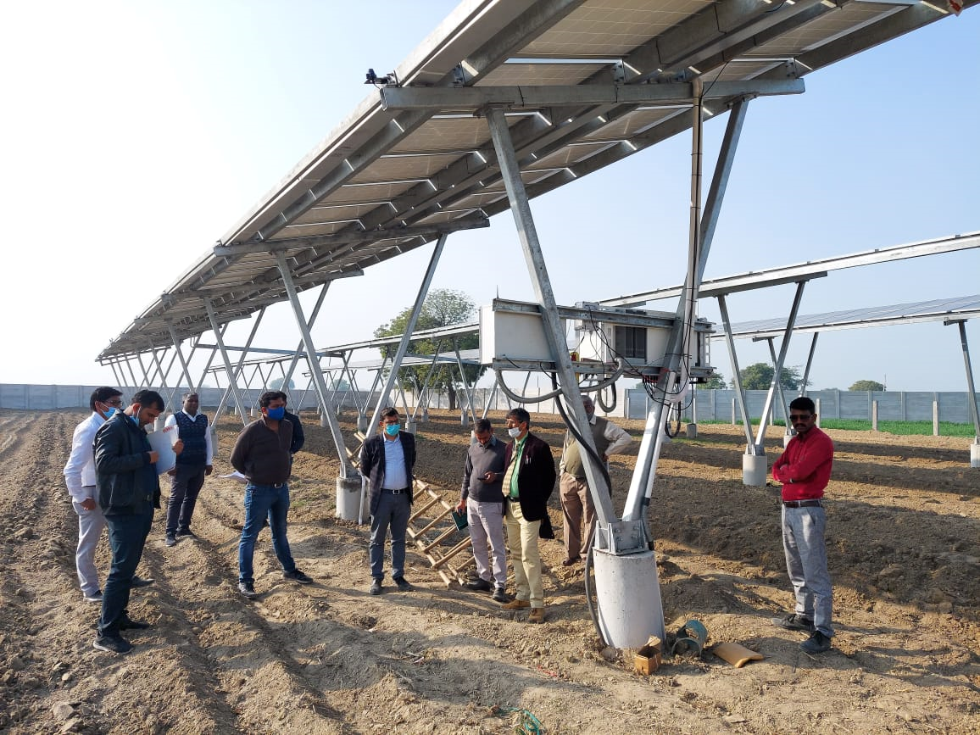
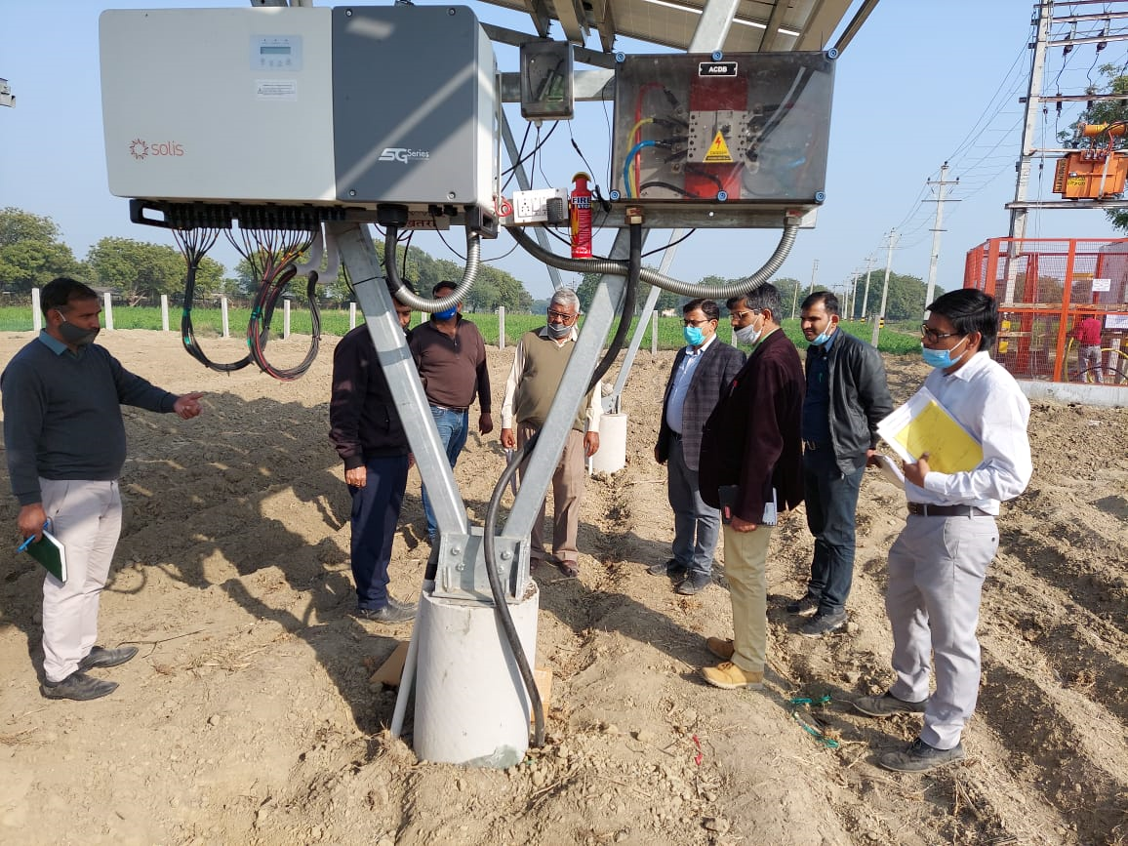
KVK (NHRDF), Delhi
Monitoring of Project by Higher Officials of GNCT Delhi
[ 10th Feb 2021 ]

Slide 18
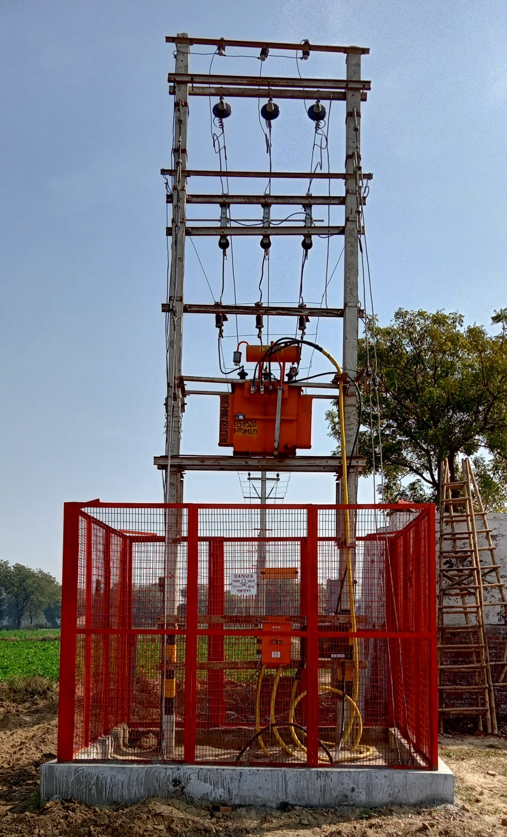
KVK (NHRDF), Delhi
Commissioning of Power Grid
12th February, 2021

Slide 19
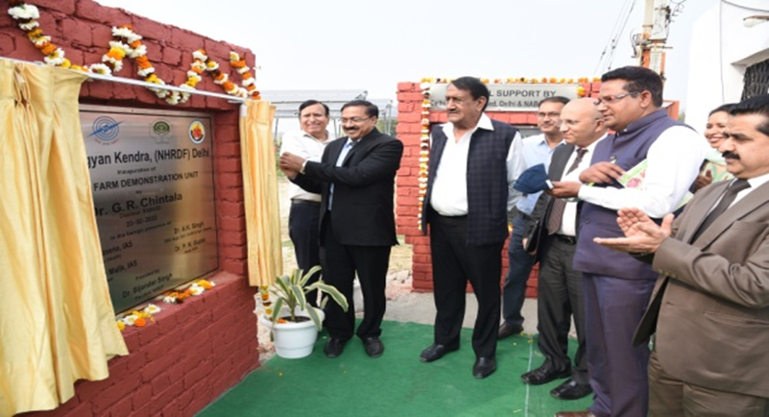
KVK (NHRDF), Delhi
Solar Farm Demonstration Unit Inauguration
Solar Farm Demonstration Unit Inauguration by Dr. G. R. Chintala Chairman NABARD

Slide 20
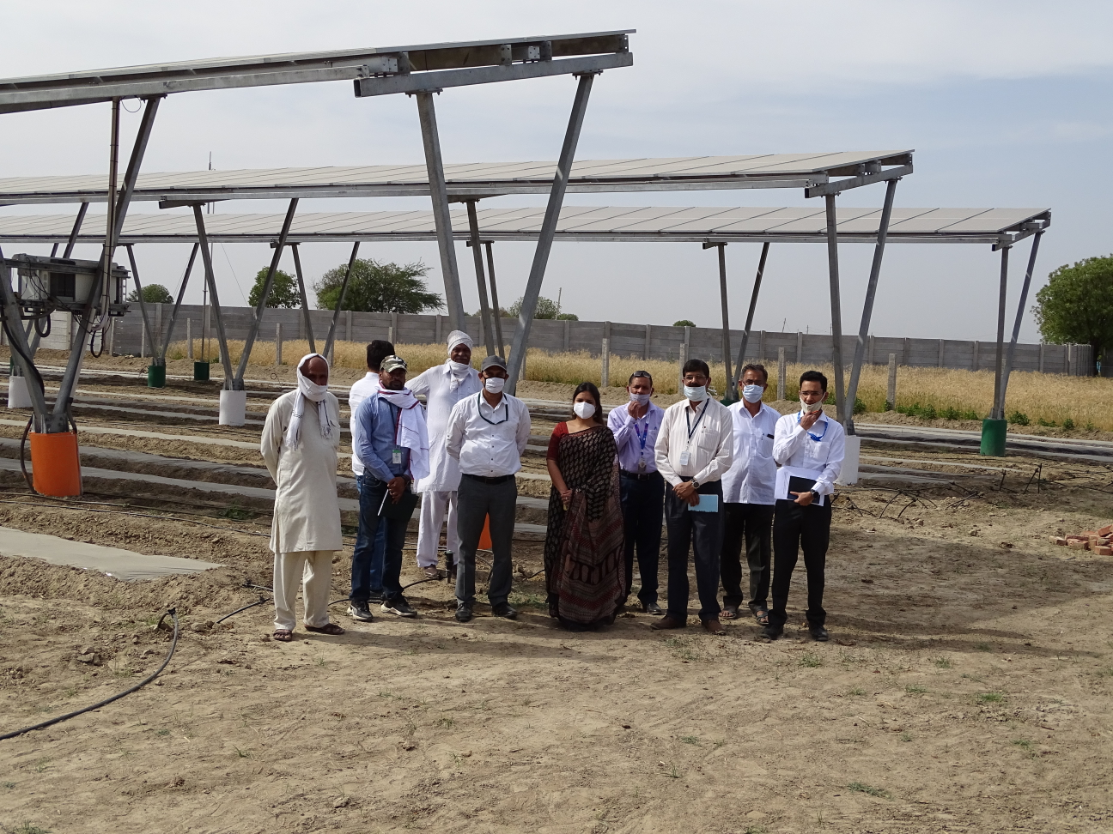
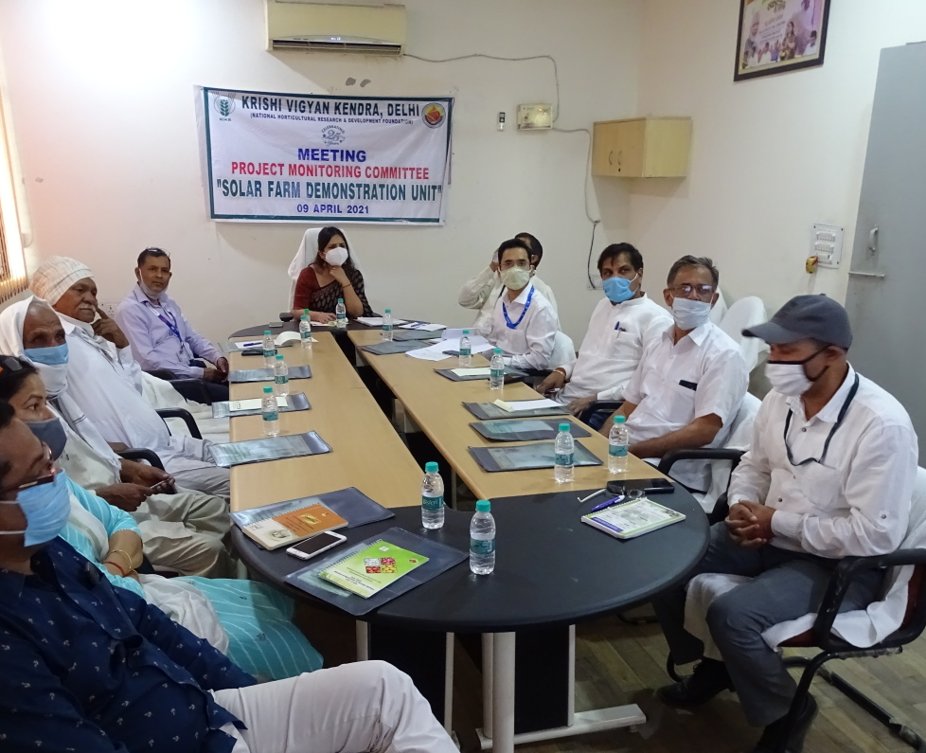
KVK (NHRDF), Delhi
Project Monitoring Committee Meeting
on 09th April, 2021

Slide 21
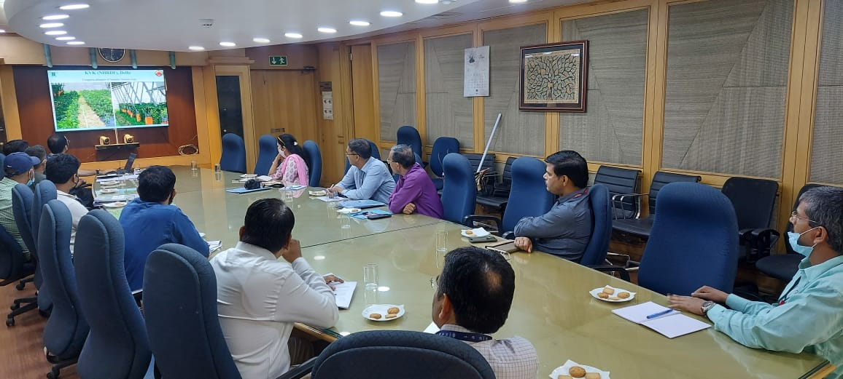
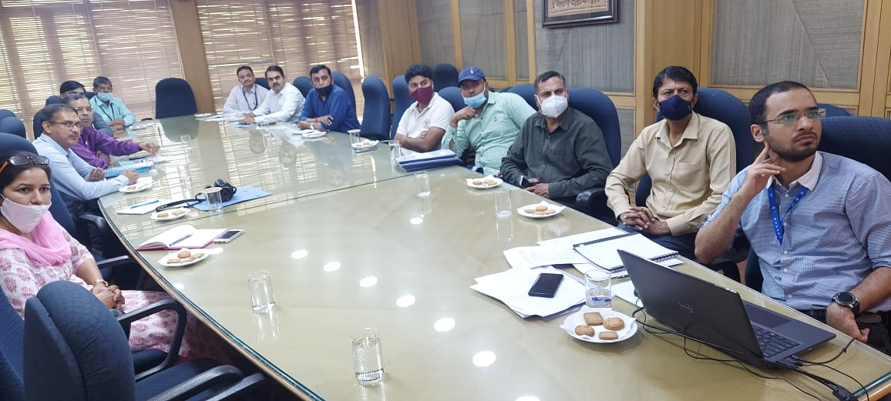
KVK (NHRDF), Delhi
Project Monitoring Committee meeting on 04th May, 2022

Slide 22
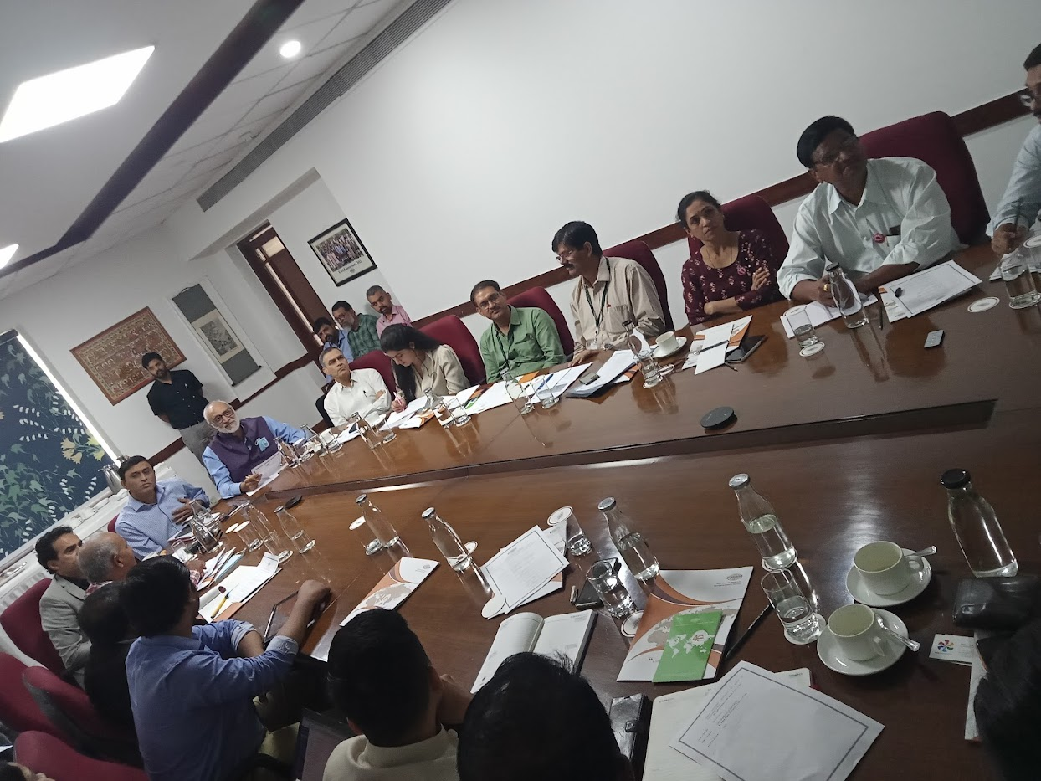
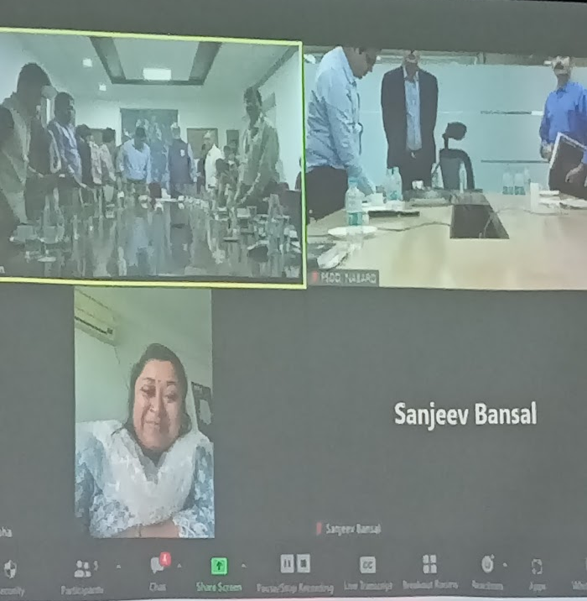
KVK (NHRDF), Delhi
Brainstorming Session on Agri-photovoltaic Value Chain: Potential of
Solar as a third crop to Triple Farmer’s income on 02 September,2022

Slide 23
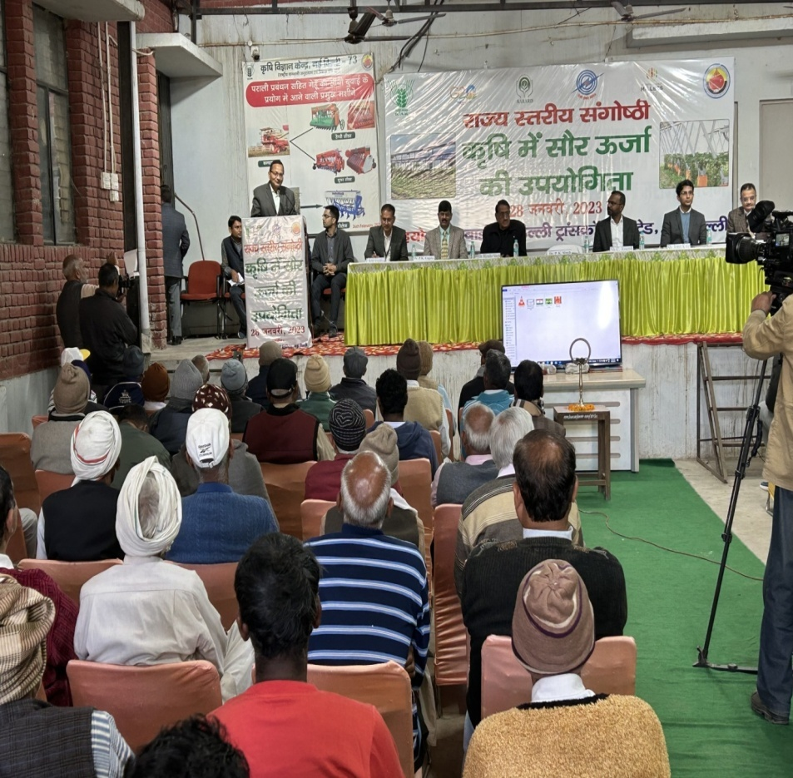
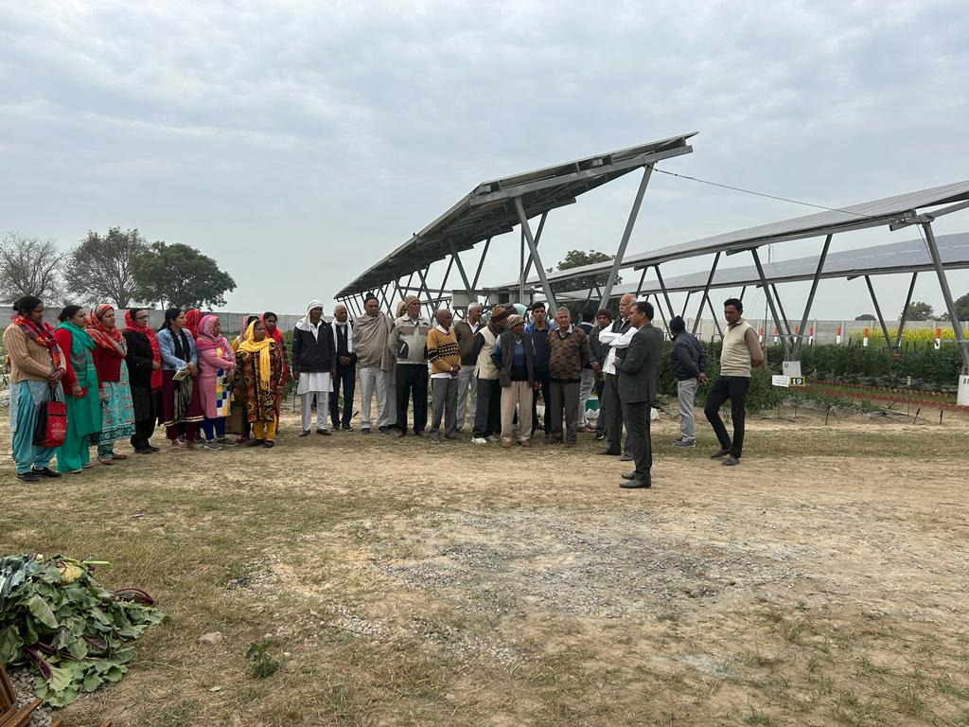
KVK (NHRDF), Delhi
State Level Seminar on “Solar Energy in Agriculture” Inaugurated
by Dr P K Singh, Ag Commissioner,Govt of India

Slide 24
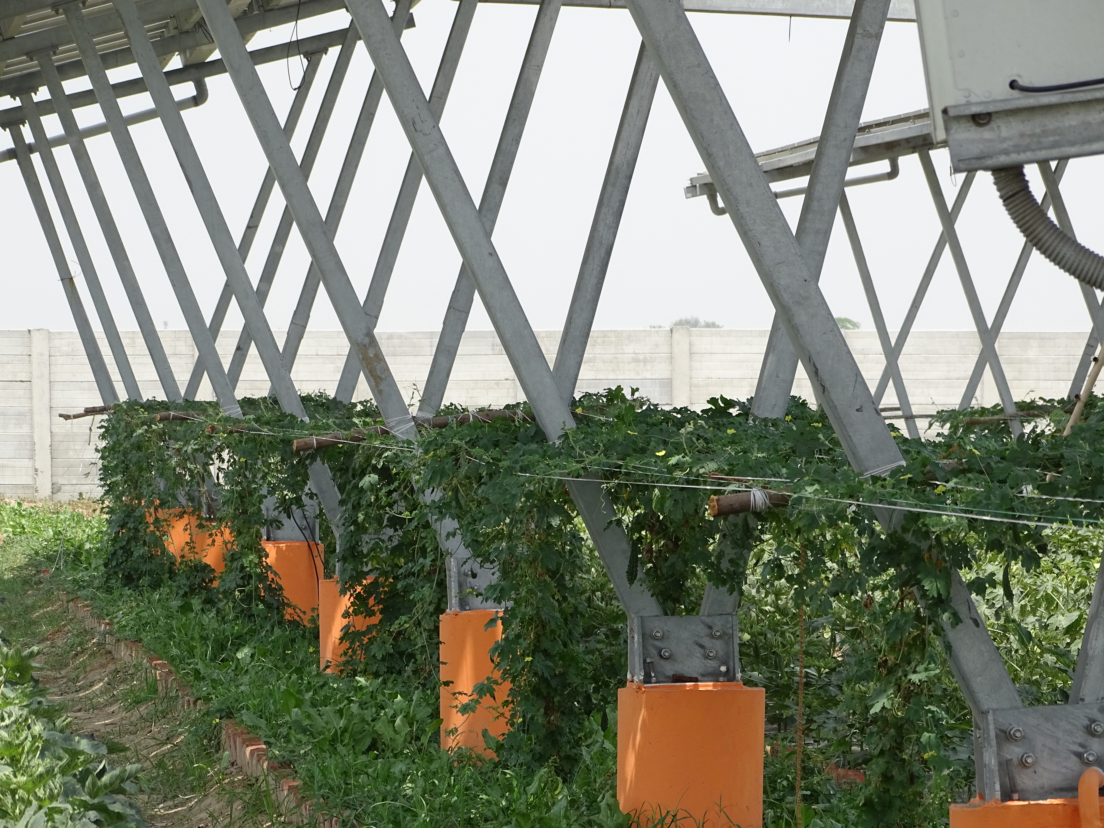
KVK (NHRDF), Delhi
Crop production under solar unit
Solar photovoltaic panel for electric unit generation
Three tierFarming system
Between ground and PV-module
Ground level farming

Slide 25
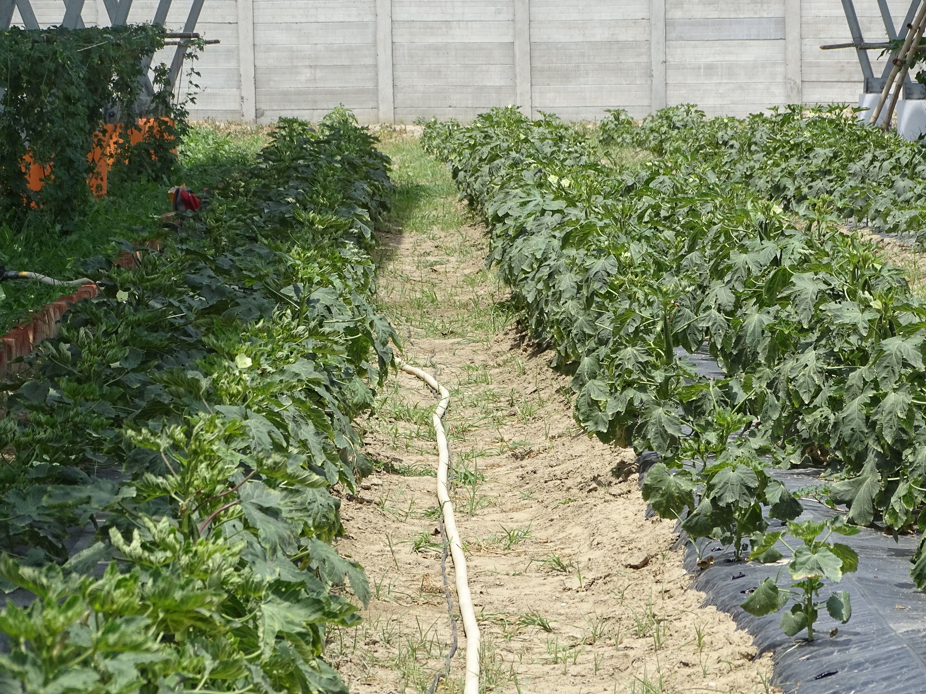
KVK (NHRDF), Delhi
Glimpses of crops at Different Stage and seasons

Slide 26
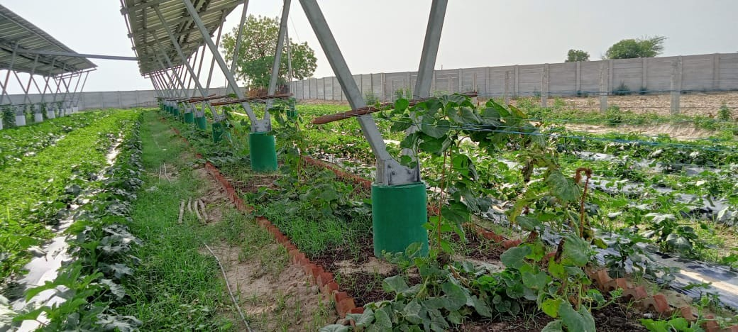
KVK (NHRDF), DELHI

Slide 27
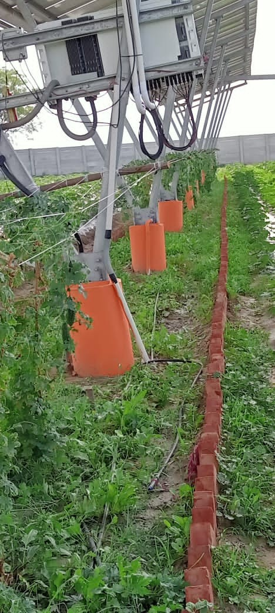
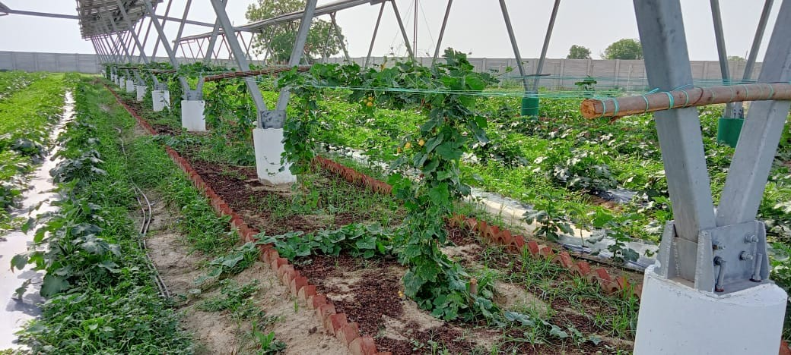
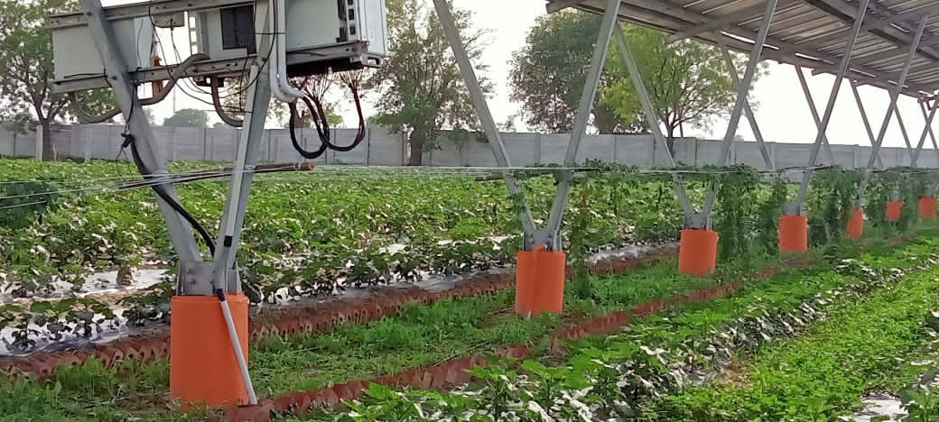
KVK (NHRDF), DELHI

Slide 28
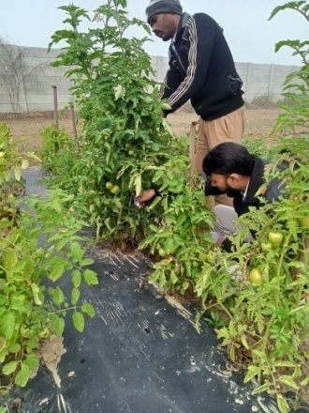
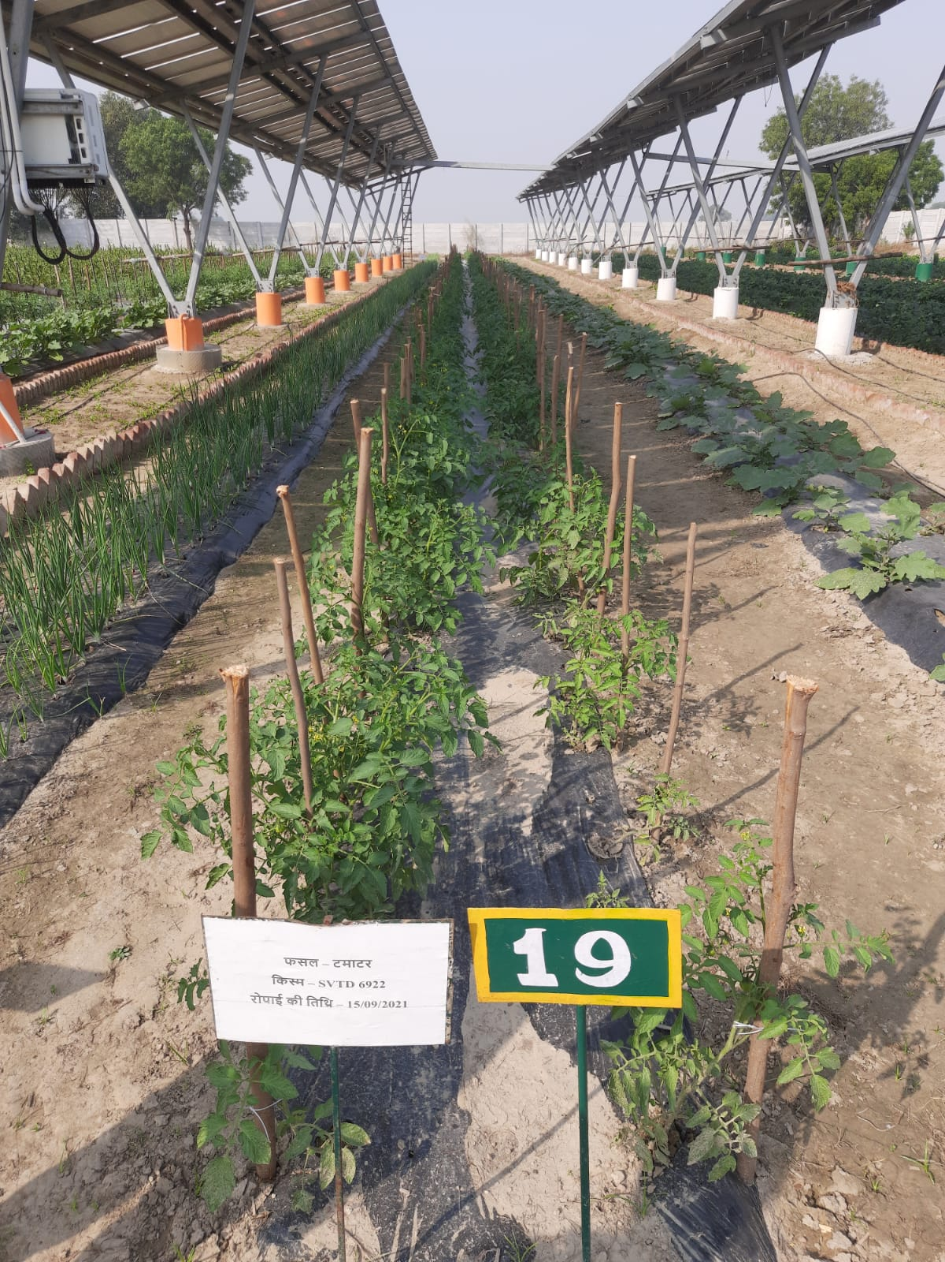
KVK (NHRDF), Delhi

Slide 29
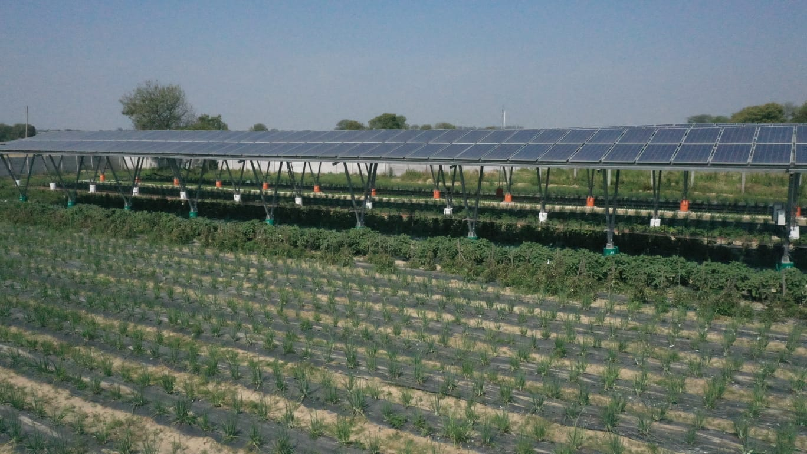
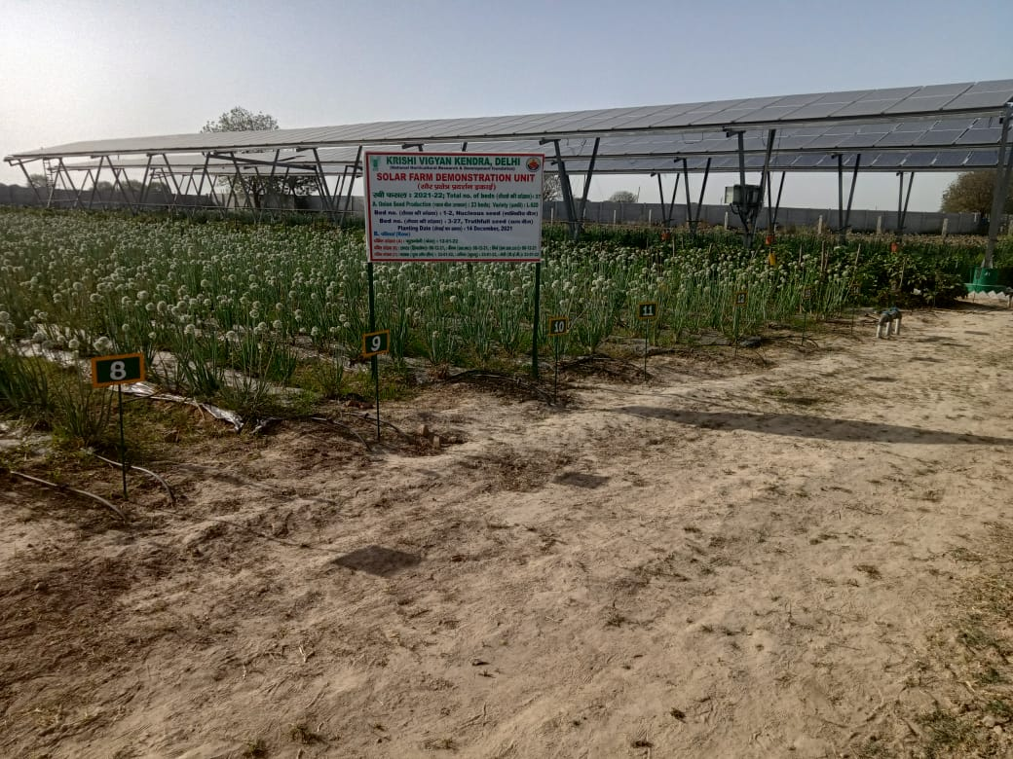
KVK (NHRDF), Delhi
Cropping glimpses of Rabi Season crops

Slide 30
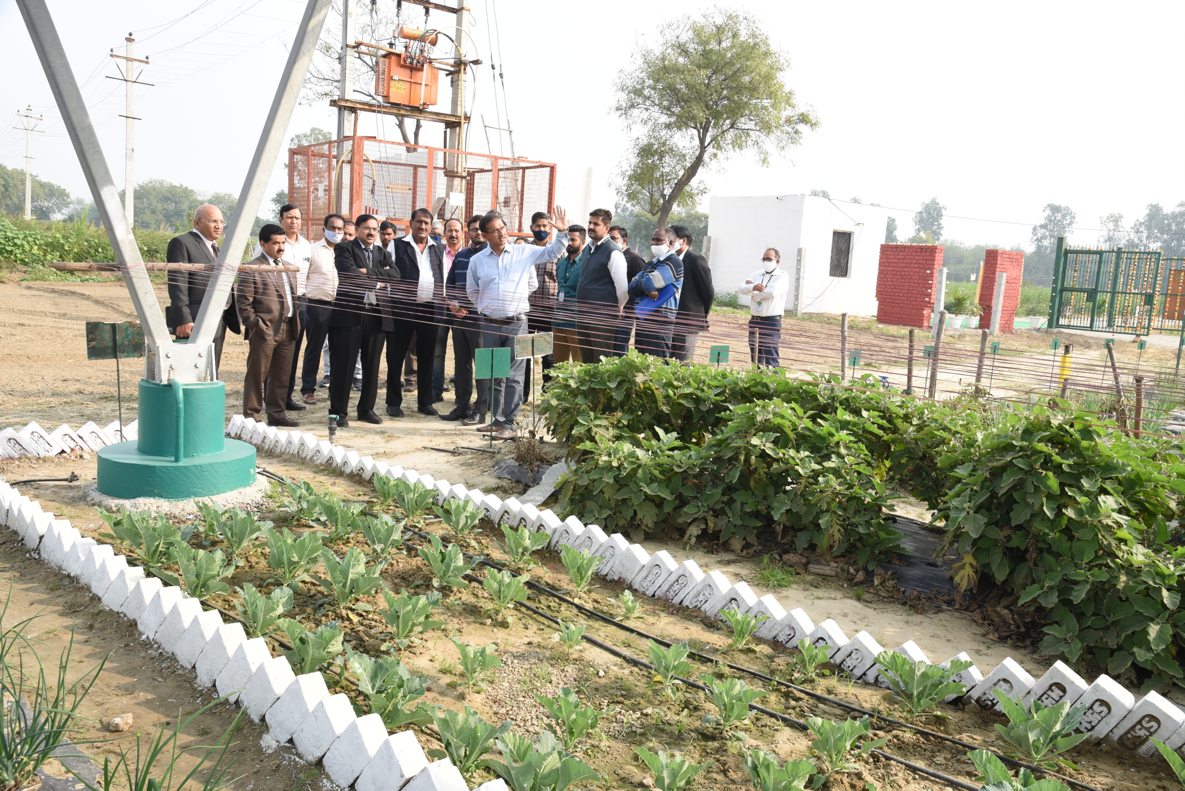
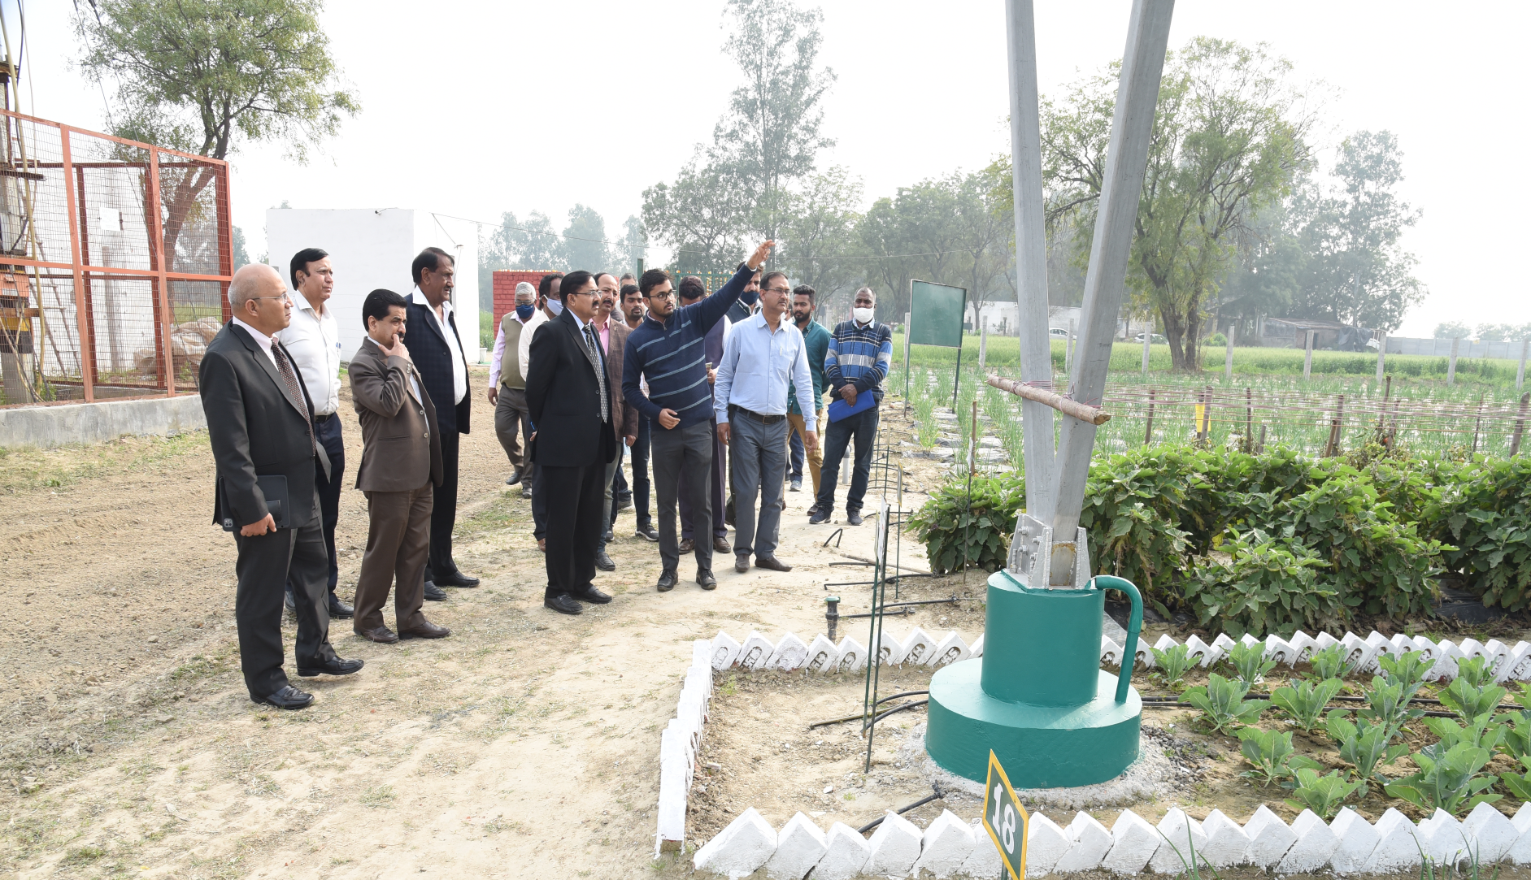
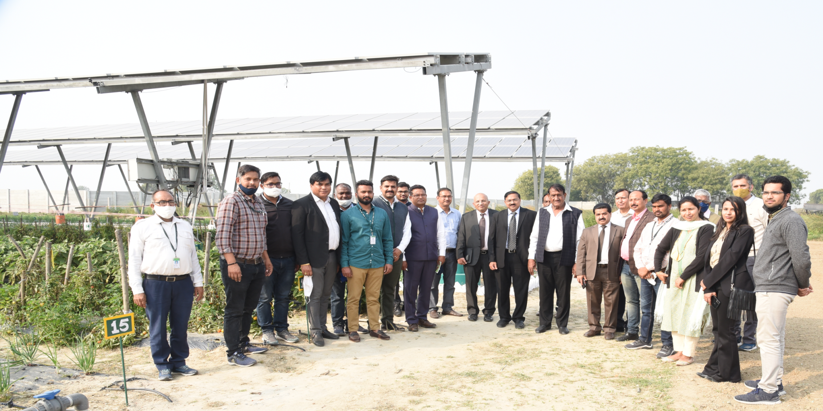
KVK (NHRDF), Delhi
Dignitaries visited at Solar Farm Demonstration Unit.

Slide 31
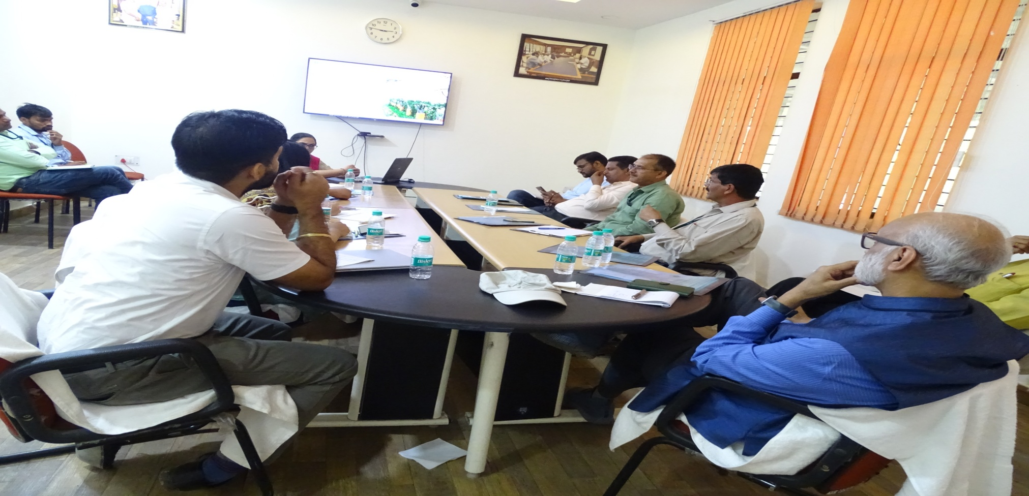
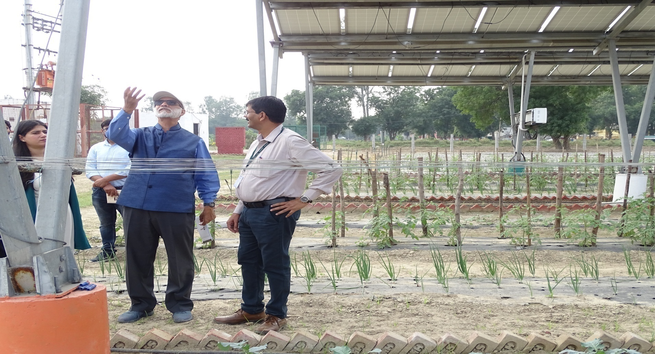
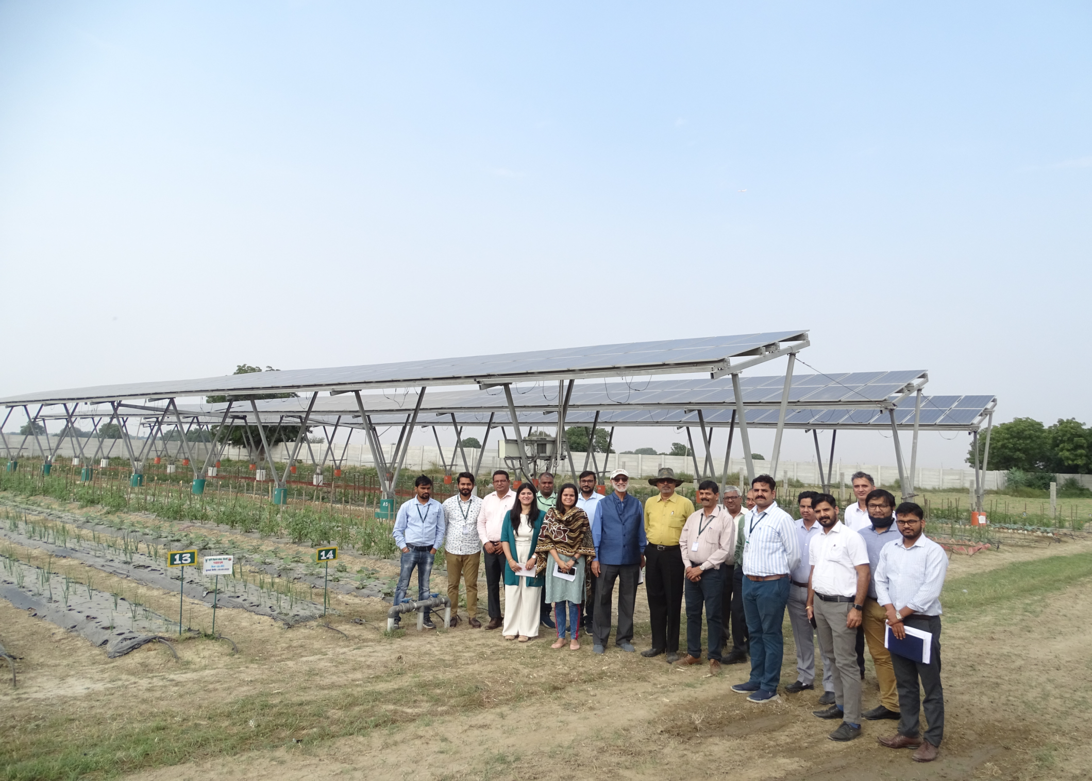
KVK (NHRDF), Delhi
Dignitaries Visits
Dr. Ashok Gulati (Professor) and team of Indian Council of International Economic Relations visited & Monitoring of KVK Solar Demonstration unit dated on 10/11/2022.

Slide 32
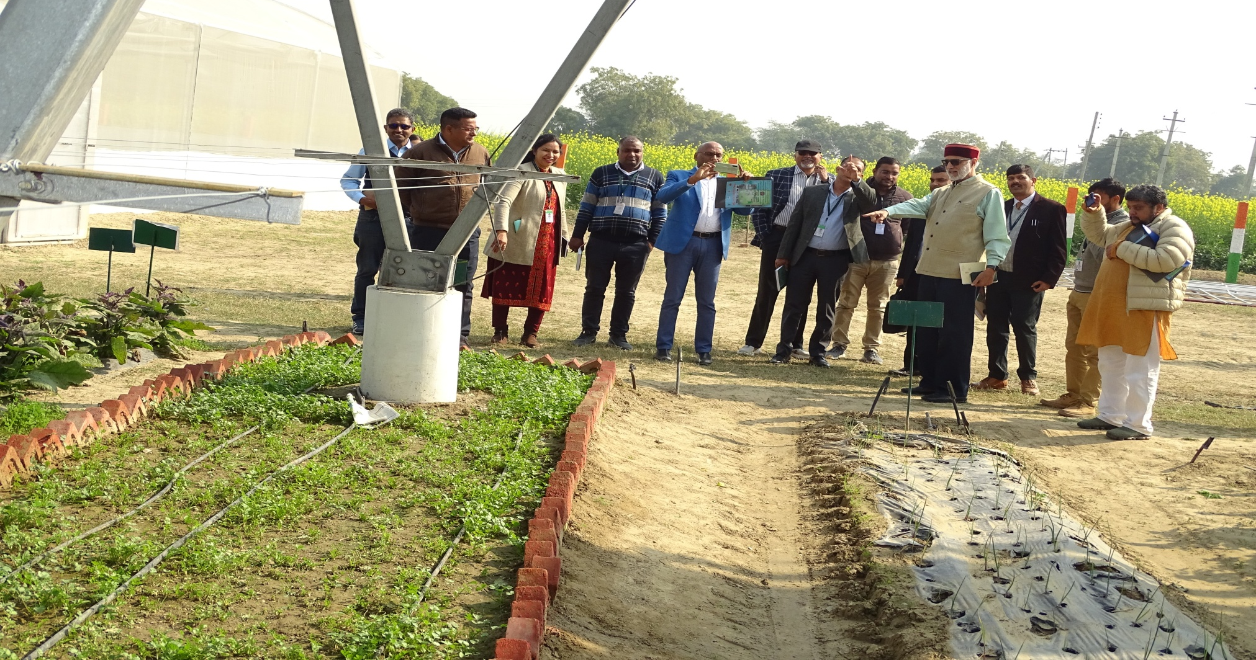
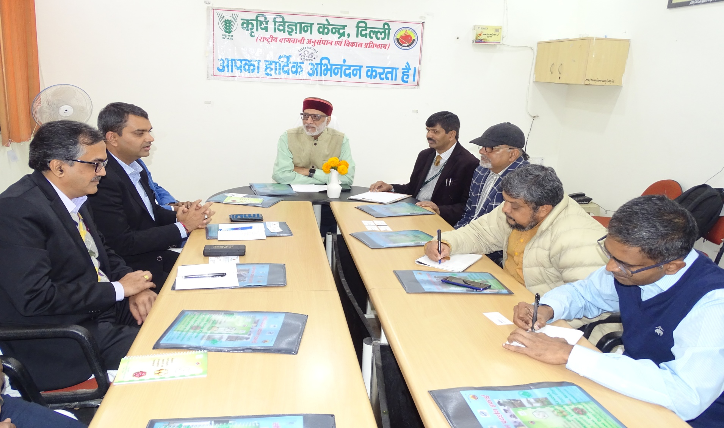
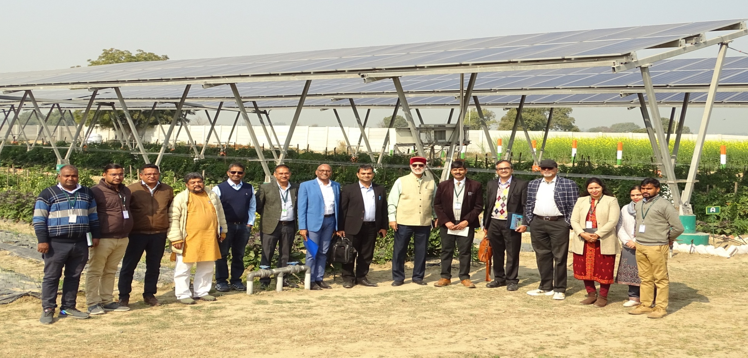
KVK (NHRDF), Delhi
Dr. Ashok Gulati (Professor) Indian Council of International Economic Relations and Mr. Dhaval Parmar, CEO & team Adani Green Energy Ltd visited & Monitoring of KVK Solar Demonstration unit dated on 24/1/2023

Slide 33
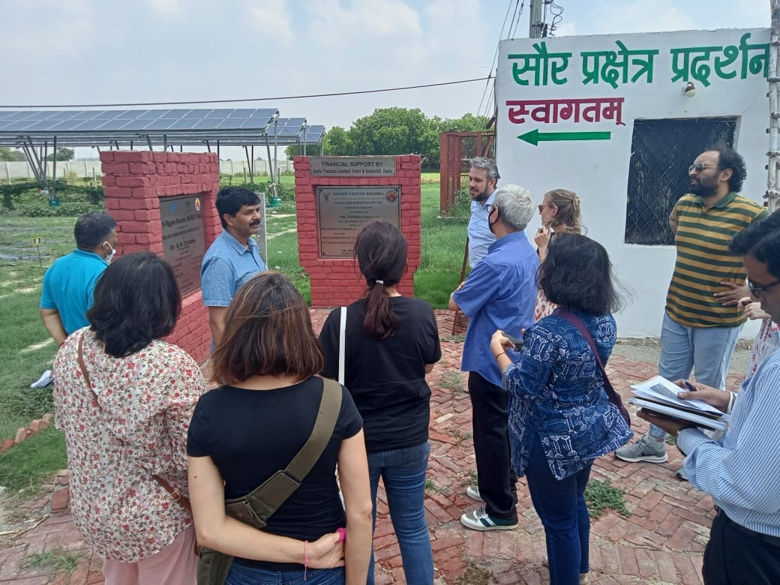
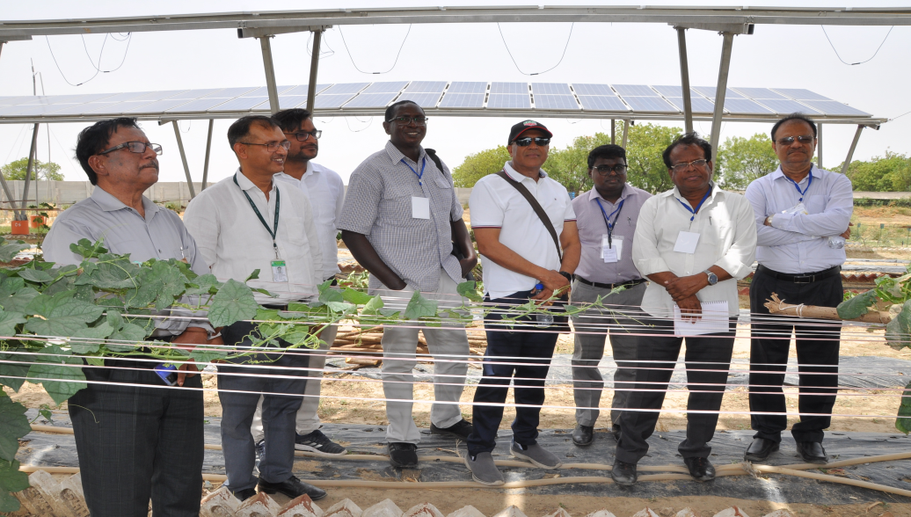
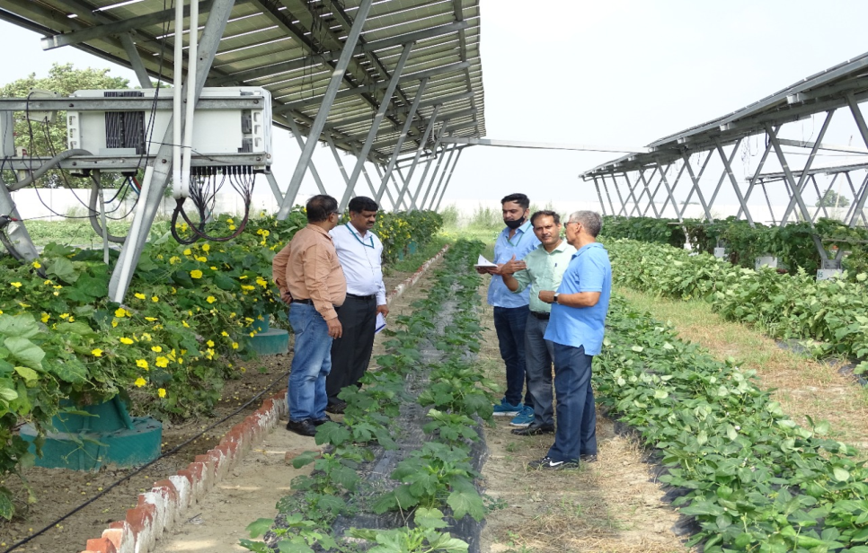
KVK (NHRDF), Delhi
Indo-German Energy Forum visited on 7th July, 2022
Dignitaries and Delegates from Australia, Bangladesh and Afghanistan visited on 8th June, 2022
The committee of ICAR-IARI, Pusa visited on 23th August,2022

Slide 34




KVK (NHRDF), Delhi
Visitors- Farmers & Students

Slide 35
Publications

Slide 36




Slide 37


Print and Electronic Media

Slide 38


KVK (NHRDF), Delhi
Media Coverage

Slide 39


KVK (NHRDF), Delhi
Media Coverage

Slide 40


KVK (NHRDF), Delhi
Publication

Slide 41
KVK (NHRDF), DELHI
Krishi Vigyan Kendra,Delhi has received a Award with Rs 10,000/ during MANAGE Agri Film Festival-2023 in film entitled Agri-Voltaics (Solar Farm Demonstration Unit) on 22nd February, 2024 at MANAGE, Hyderabad.G:\KVK Delhi - Solar Farm Demonstration.mp4 ..\Desktop\6. Hindi_ KVK (NHRDF), Delhi .pdf

Slide 42

KVK (NHRDF), DELHI
Maintenance
Issues during construction
Agriculture related issues

Slide 43

KVK (NHRDF), Delhi
Thank You

